Slide 1









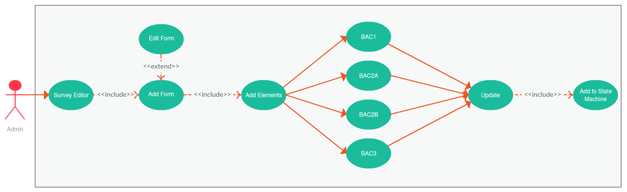
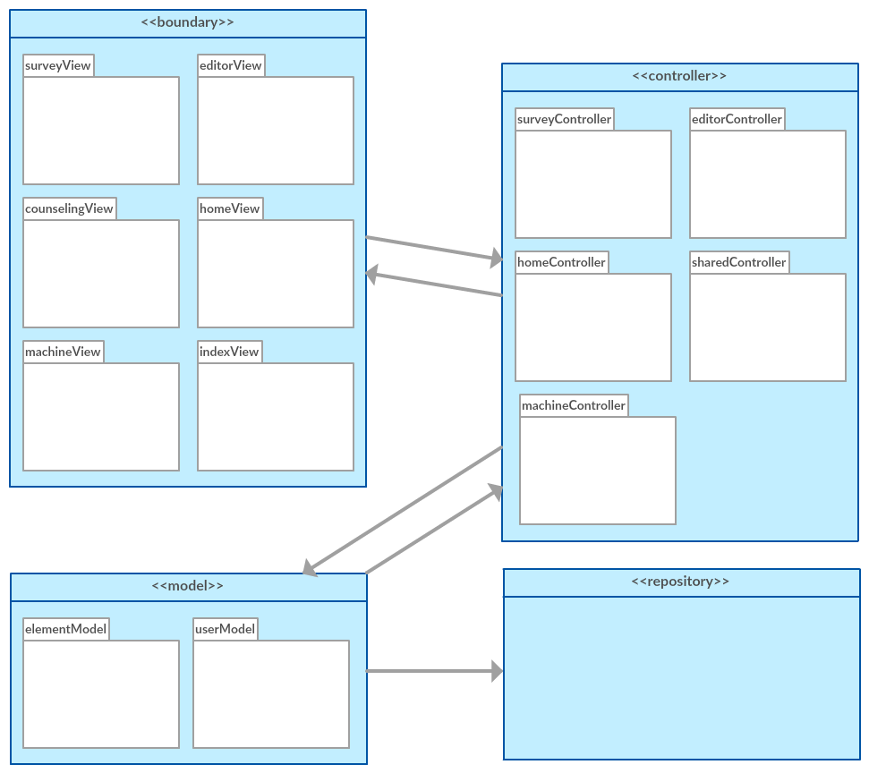
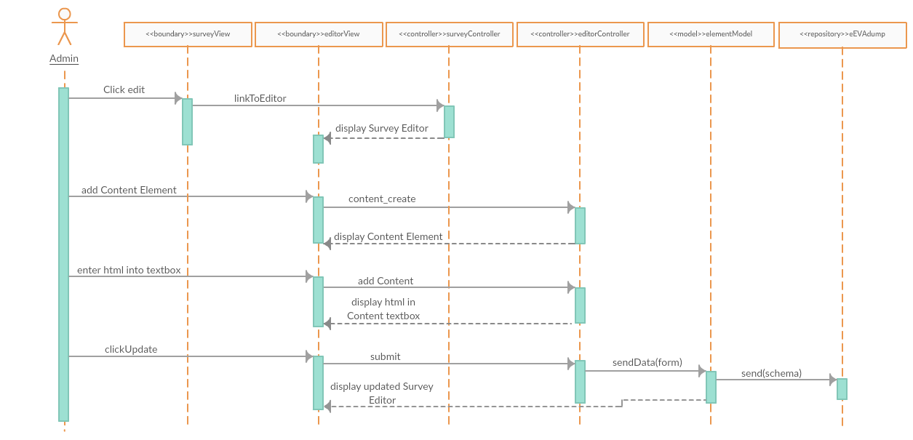
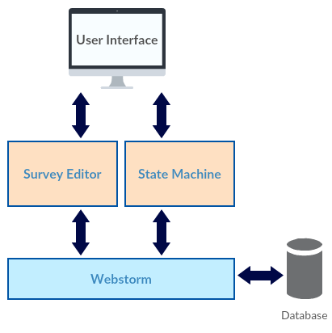
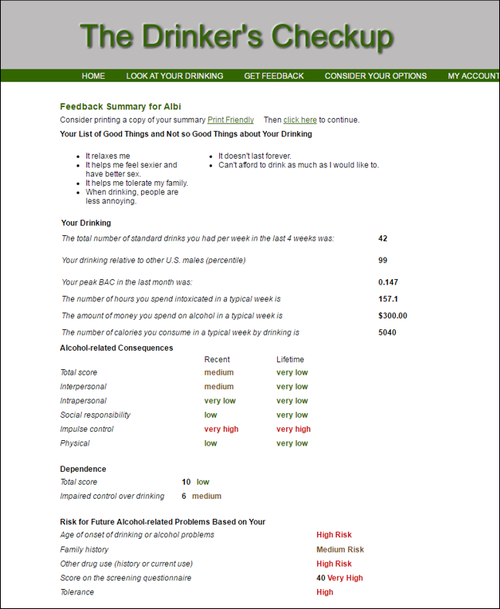
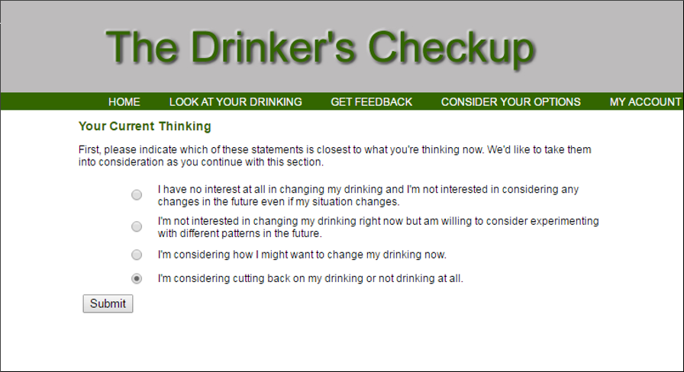
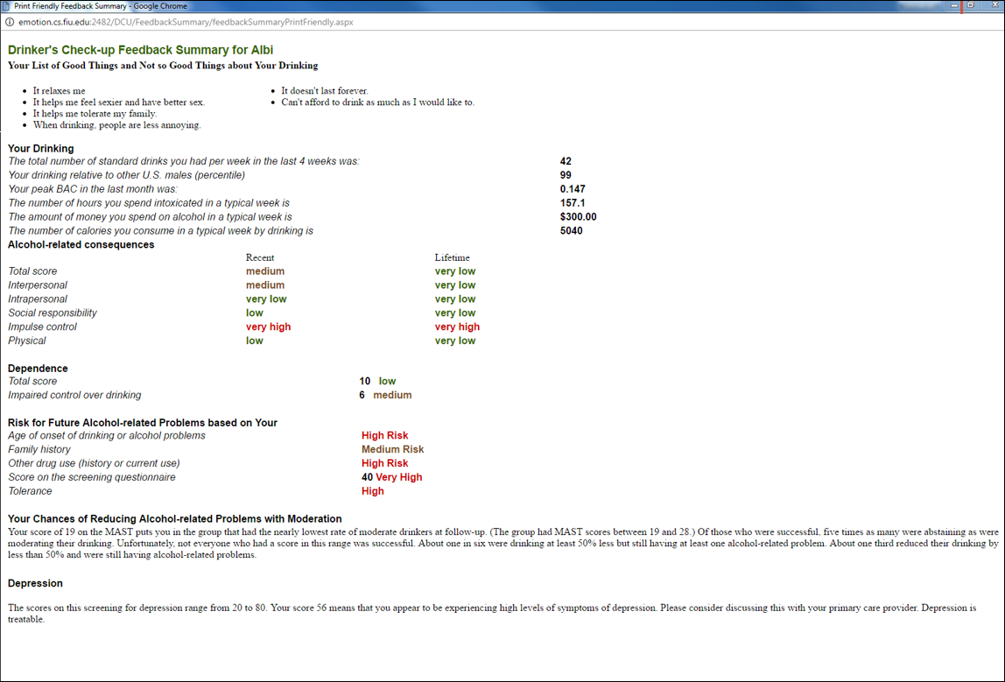
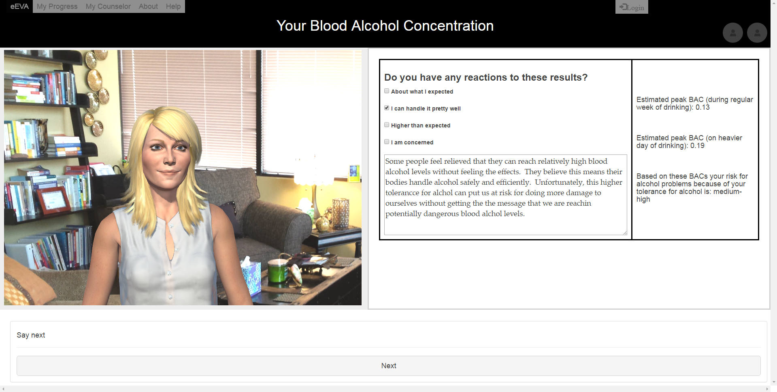
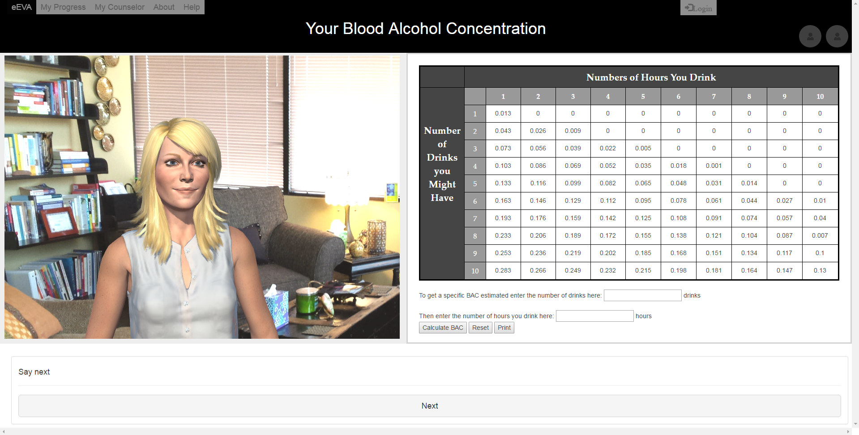
School of Computing & Information Sciences
Senior Project, 2016, Fall
eEVA Data Generation and User Results Analysis v1.0
Student: Carlos Mestre, Florida International University
Product Owner: Christine Lisetti, Florida International University
Mentor: Mohsen Taheri, Florida International University
Instructor: Masoud Sadjadi, Florida International University
Problem
Current System
Requirements
Brief Motivational Intervention is a technique used to initiate change for an unhealthy or risky behavior such as alcohol misuse. The current DCU (Drinker’s Check-Up) system is being overhauled to provide a better experience and be a more effective tool for the end user.
Text based system
No interactivity with the user
No explanation of what the scores or result categories mean
Implement a summary section in which the counselor interacts with the user using both text and speech
Use up to date HTML/CSS/JS features such as interactive tables and graphs to engage the user into his/her results
Provide users instant feedback dependent on their scores
Implement a Printer Friendly version of content
User Interaction
Adding HTML content to the eEVA system
Use Case diagram
Sequence diagram
System Design
eEVA v1.0 class-min-view
Implementation
System was designed by means of MEAN Stack
The web app interface was made using HTML, CSS, JQuery, Node.js, and Angular.js
To create content, the user interacts with 2 main systems, Survey Editor and State Machine.
Those systems inject content into Webstorm and store it in the database
Screenshots
Current text-based system
Verification
Functionality Testing:
The main goal for using Functionality Testing was for the results pages to be serviceable throughout the system by verifying that the links worked correctly, and the interactive objects inserted responded as intended
Issues were found where certain HTML, CSS, and JS commands would not function in our system
Angular.js graphs needed to respond correctly to data being passed into/from the server
eEVA v1.0
Summary
eEVA Data Generation and User Result Analysis Version 1.0 is now set so that the counselor can interact with the user regarding their results. The operator can visit different pages using either voice commands or by clicking buttons which were implemented throughout the application. The system is now set up to allow printer friendly pages. We did encounter issues with the system, which our team has debugged. Team Mestre/Lunn leaves the system in a good place for future work and wish the best of luck to upcoming teams.
My Role
HTML design of webpages
Build dynamic table using JavaScript functions interacting with user entered data
Design an interactive checkbox feature which responds depending on user’s feelings about their scores
Acknowledgement
The material presented in this poster is based upon the work supported by my product owner Christine Lisetti and the Affective Social Computing Laboratory (http://ascl.cis.fiu.edu/). I am thankful for the help that I have received from my group member Stephanie Lunn and the ASCL lab team.
Notes:
1

